Slide 1



Pranjal Ekhande
Wildlife Capture
Using the EfficientNetB7 and PytorchWildlife
DATA SCIENCE WITH PYTHON

Slide 2













Goal of Project
To Filter Irrelevant images.
Accurately classify wildlife using Camera Traps Images

Slide 3
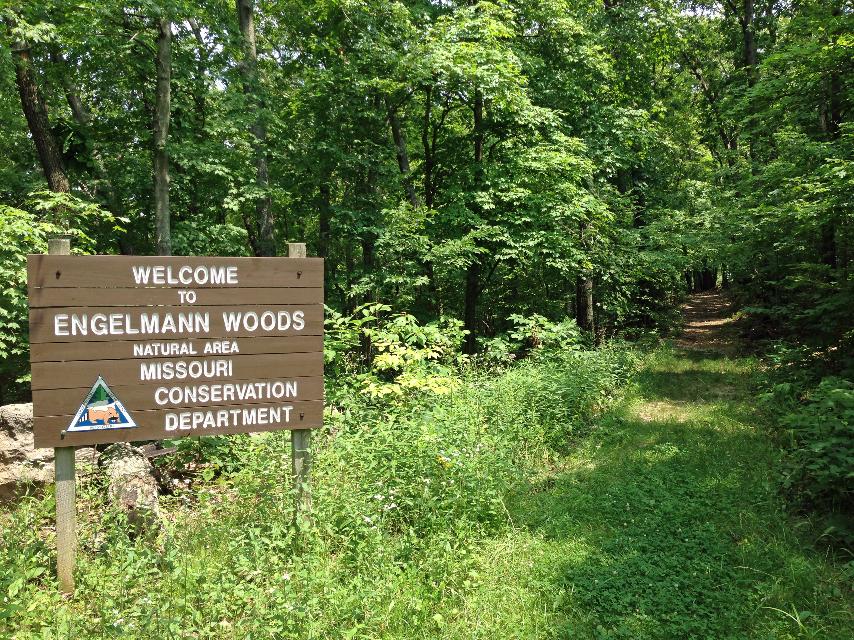
Dataset
Problems
Highly cluttered and dynamic scenes
70% of the images lacked wildlife content in it.
Spatial resolutions of the images varied from 1920 × 1080 to 2048 × 1536.
LILA BC - Labeled Information Library of Alexandria: Biology and Conservation
25,000 camera trap images representing 20 species (eg. red deer, mouflon)

Slide 4
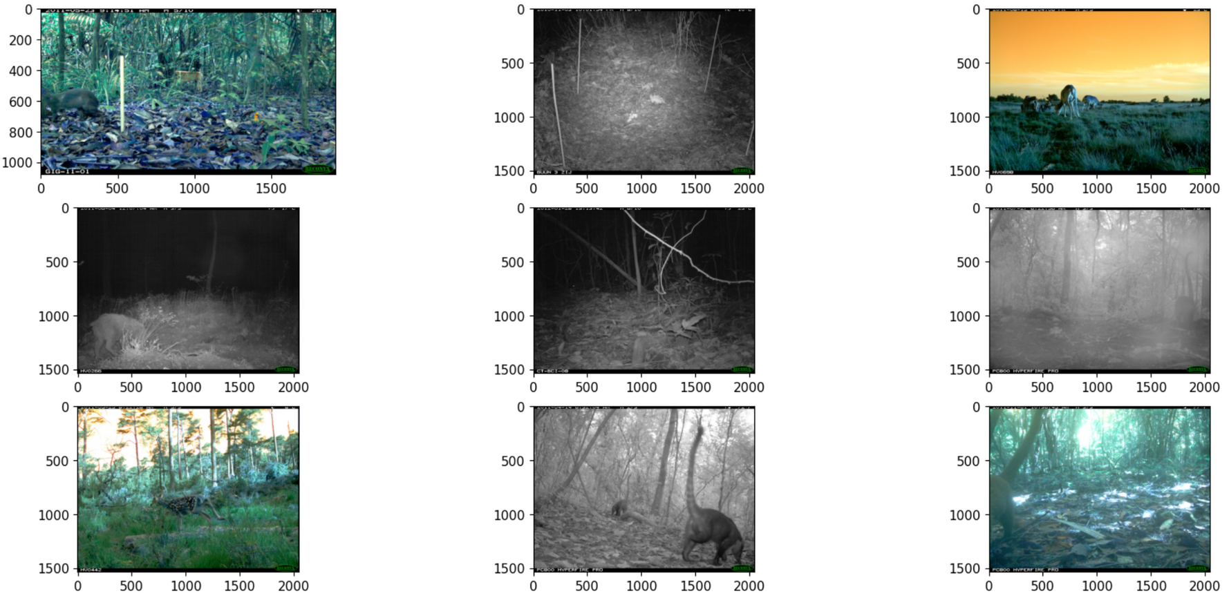
Random Images from Dateset

Slide 5

Solution
Data Filtering
Pre-processing Images
EfficientNetB7
Result
MegaDetector_v5_Transform for Filtering and Detecting animals in images.
Pre-trained CNN model.
Models trained for 100 Epochs with Early Stopping enabled.
78% Images got filetered using MegaDetector
Output Saved Images and bounding boxes and classification of wildlife with 40% Accuracy
Grey-scale, CLAHE (Contrast Limited Adaptive Histogram Equalization), Blurring and Smoothing

Slide 6
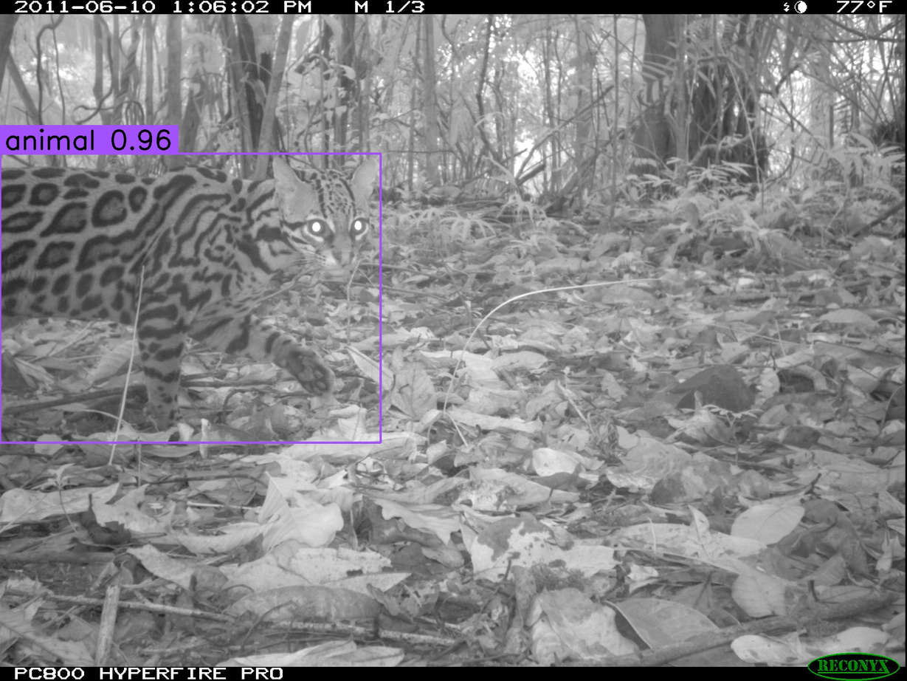
MegaDetector Detection

Slide 7
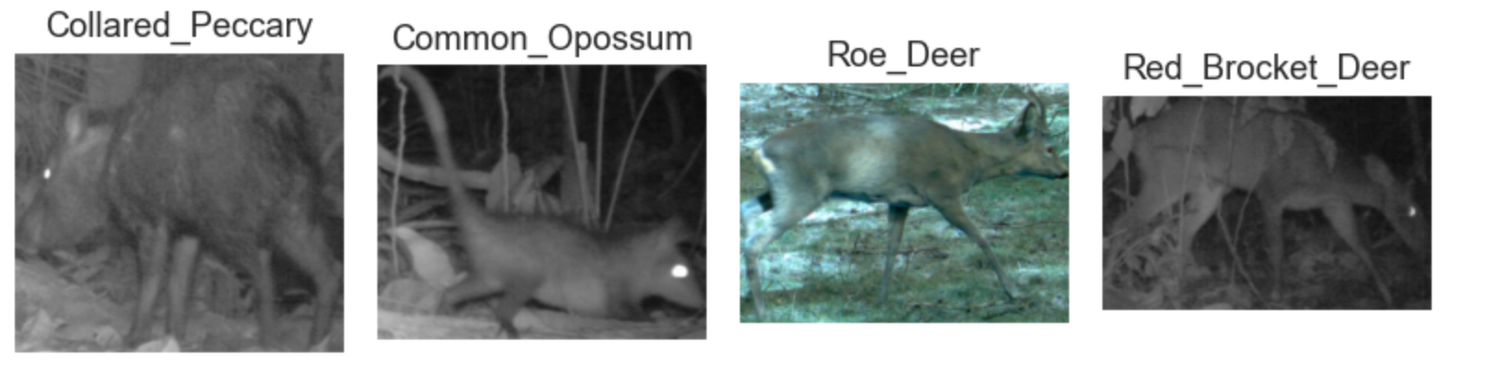
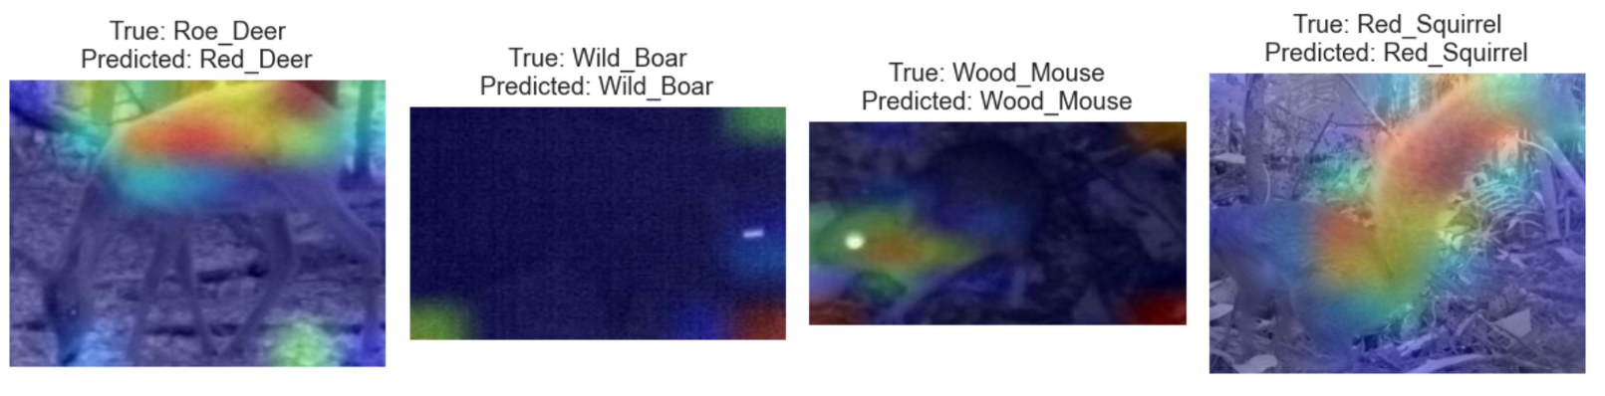
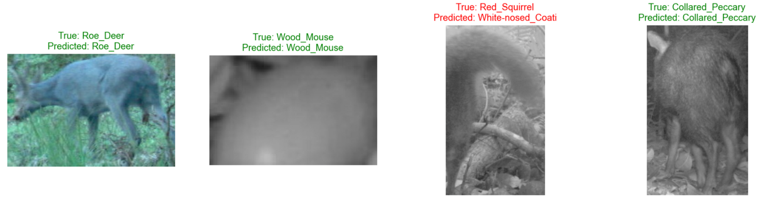
Preprocessing
and
EfficientNetB7

Slide 8
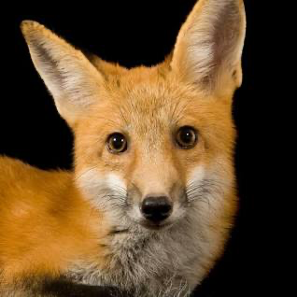
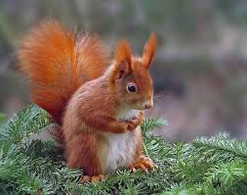
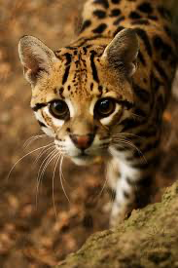
Future Work
Tracking Movement
Identifying Behaviour
Realtime Identificaton
Analysing the Movement of animals based on location data
Identify more subtle animal behaviors using image metadata
Integrate this with realtime camera traps

Slide 9
Thank you!

